Slide 1
Rent and Royalty Income
Form 1040 – Line 17
Pub 4012 – Tab D
Pub 4491 – Part 3 – Lesson 13
Entire Lesson
Notes:
It is best if counselors review pubs 4491 and 4012 on this topic before coming to class
Pub 4491 Chapter 13
Pub 4012 Tab D
Form 1040 Line 17
Release 2 Change: -- Added slides 12-15 to deal with less than 15 day rental of a taxpayer's home.

Slide 2
Scope – Rent and Royalty
1099-MISC In Scope
  Rent
  Royalty
K-1 In Scope
  Royalty
  NOT Rent

Slide 3
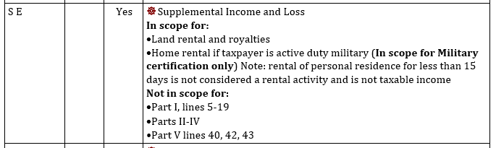
Scope – Schedule E
Per the TaxAide Scope Manual
Expenses Out Of Scope

Slide 4
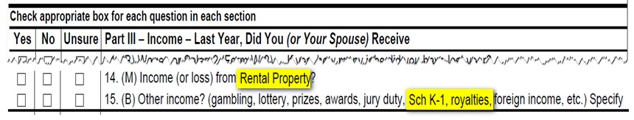
Intake and Interview Form
Look for 1099-MISCs and K-1s with
Rent and/or Royalty

Slide 5
Rent
Rent income in-scope if
  Land OR gas/oil lease
  Reported on a Form 1099-MISC
  Received from individual and not reported on 1099-MISC
No Expenses EXCEPT property tax
  Report on Schedule A
Rent reported on a K-1 – Out-of-scope

Slide 6
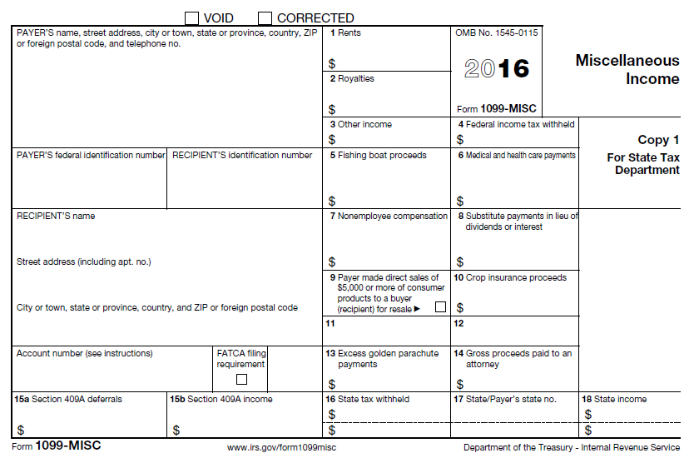
Rents reported on 1099-MISC

Slide 7

Enter Rent on Schedule E
Select 1099-MISC by entering form number or using QuickFile in TaxSlayer
TaxSlayer will prompt Schedule E when 1099-MISC is completed
If no 1099-MISC add Sch E by entering form number or link line 17 of 1040 view

Slide 8
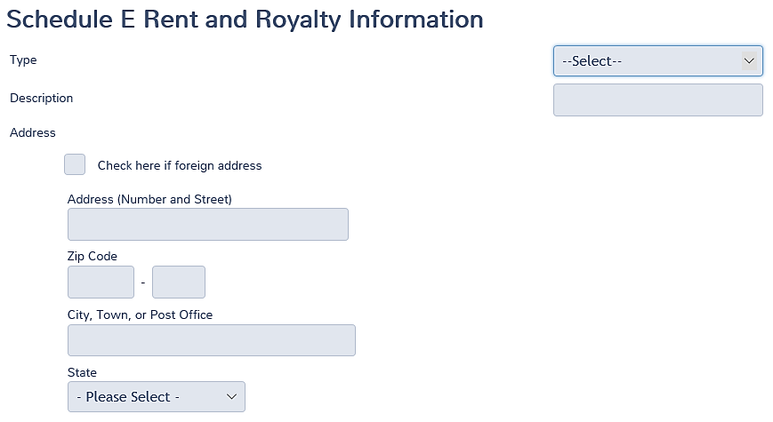
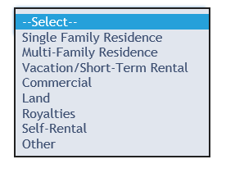
Schedule E in TaxSlayer
Select Land from dropdown menu

Slide 9
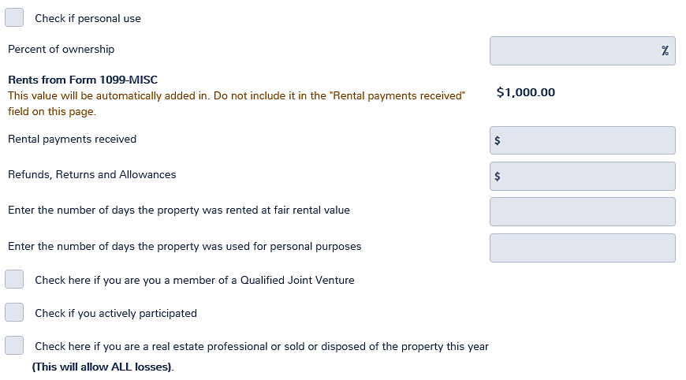
Schedule E in TaxSlayer
Required Entry
Enter rent not on 1099-MISC

Slide 10
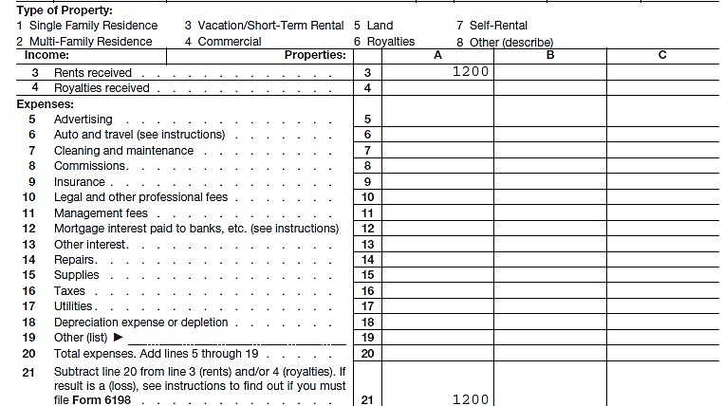
Schedule E
No Expenses Allowed on Schedule E

Slide 11
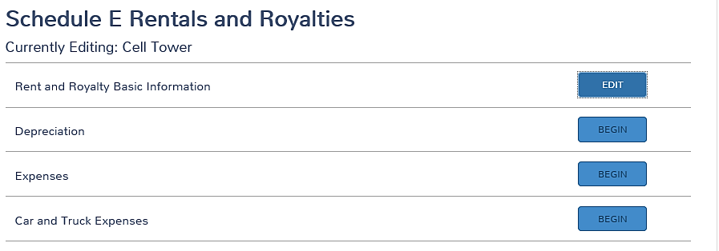
Schedule E in TaxSlayer
No expenses allowed on Sch E

Slide 12
Special situation – Rent <15 Days
From Pub 17:
“If you rent property that you also use as your home and you rent it less than 15 days during the tax year, do not include the rent you receive in your income and do not deduct rental expenses. However, you can deduct on Schedule A (Form 1040) the interest, taxes, and casualty and theft losses that are allowed for nonrental property.”

Slide 13
Special situation – Rent <15 Days
If no tax form was received for the rent, it is not reported on the return
If a 1099-MISC is received enter the 1099-MISC, and Sch E and deduct the same amount as an “other expense” (Less than 15 day exclusion)

Slide 14
Schedule E – Rent < 15 Days
Select Single Family Residence from dropdown menu

Slide 15
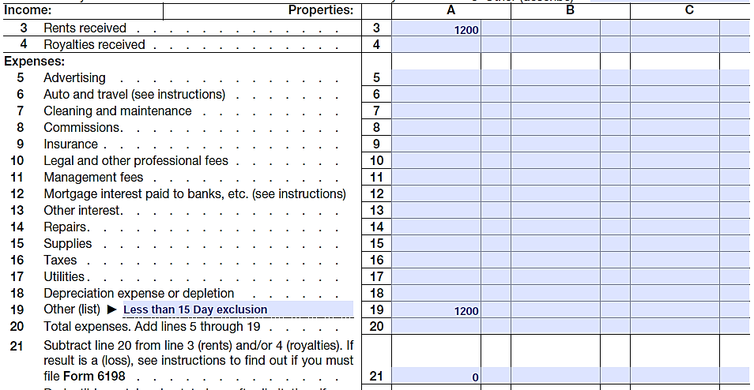
Schedule E - Rent < 15 days

Slide 16
Royalties
Royalties from a gas/oil lease or similar are In-Scope if reported on K-1 or 1099-MISC (Sch E)
Royalty from own personal services is business income on Sch C (such as author’s or entertainer’s royalty)
Notes:
All Form 1099-MISCs must be input into TaxSlayer; see NTTC Training Slides “23c Income Form 1099-MISC TY 16 Rel 2” for more guidance.

Slide 17
Royalties reported on 1099-MISC

Slide 18
Enter Royalties on Schedule E
Select 1099-MISC by entering form or using QuickFile in TaxSlayer
TaxSlayer will prompt Schedule E when
1099-MISC is completed
Royalties will be automatically selected
If no 1099-MISC , add Sch E by entering form number or link line 17 from 1040 view
Complete Schedule E as previously described

Slide 19
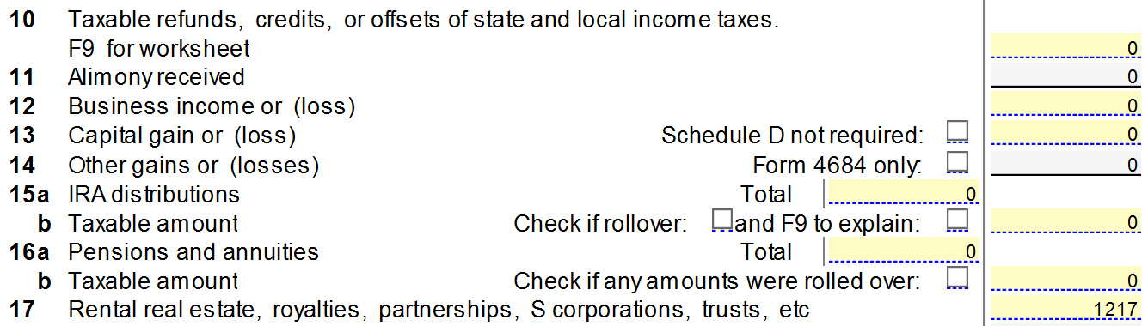
Sch E Transfers to 1040 line 17

Slide 20
Royalties on K-1
Enter data on the K-1 in TaxSlayer
Income will carry to line 17 of Form 1040
See separate lesson on K-1

Slide 21
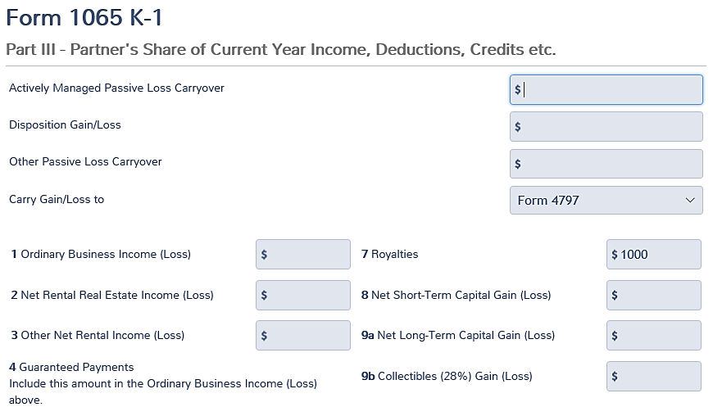
K-1 Royalties in TaxSlayer

Slide 22
Quality Review
Are Rent and Royalty entries In-Scope?
Is Royalty income from a personal business (Sch C) of the taxpayer?
Are 1099-MISC entries correct?
Has information been properly entered on Sch E and/or K-1?
Check for proper transfer of income to 1040 line 17

Slide 23
Any Questions/Comments?

